Slide 1
Calculo Numérico I Métodos Iterativos: método de Gauss-Seidel
Dr. Luis Sanchez

Slide 2
Gauss-Siedel
Iterative or approximate methods provide an alternative to the elimination methods. The Gauss-Seidel method is the most commonly used iterative method.
The system [A]{X}={B} is reshaped by solving the first equation for x₁, the second equation for x₂, and the third for x₃, …and n^{th} equation for x_{n}. We will limit ourselves to a 3x3 set of equations.

Slide 3
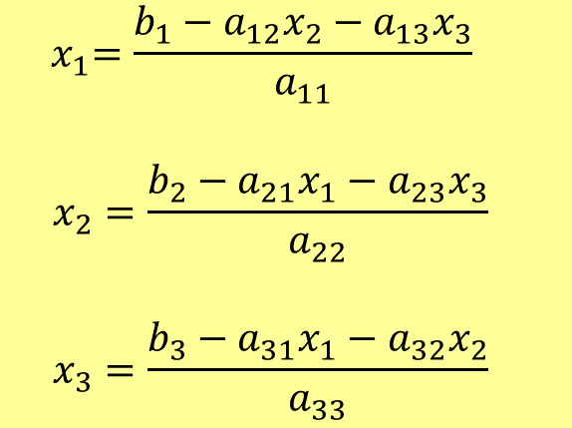
Gauss-Siedel
$${ x}_{1}=\frac{b_{1}−a_{12}x_{2}−a_{13}x_{3}}{a_{11}}$$
$$x_{2}=\frac{b_{2}−a_{21}x_{1}−a_{23}x_{3}}{a_{22}}$$
$$x_{3}=\frac{b_{3}−a_{31}x_{1}−a_{32}x_{2}}{a_{33}}$$
Now we can start the solution process by choosing guesses for the x’s. A simple way to obtain initial guesses is to assume that they are zero. These zeros can be substituted into x₁ equation to calculate a new x₁=b₁/a₁₁.

Slide 4
Gauss-Siedel
New x₁ is substituted to calculate x₂ and x₃. The procedure is repeated until the convergence criterion is satisfied:

Slide 5
Jacobi iteration Method
An alternative approach, called Jacobi iteration, utilizes a somewhat different technique. This technique includes computing a set of new x’s on the basis of a set of old x’s. Thus, as the new values are generated, they are not immediately used but are retained for the next iteration.

Slide 6
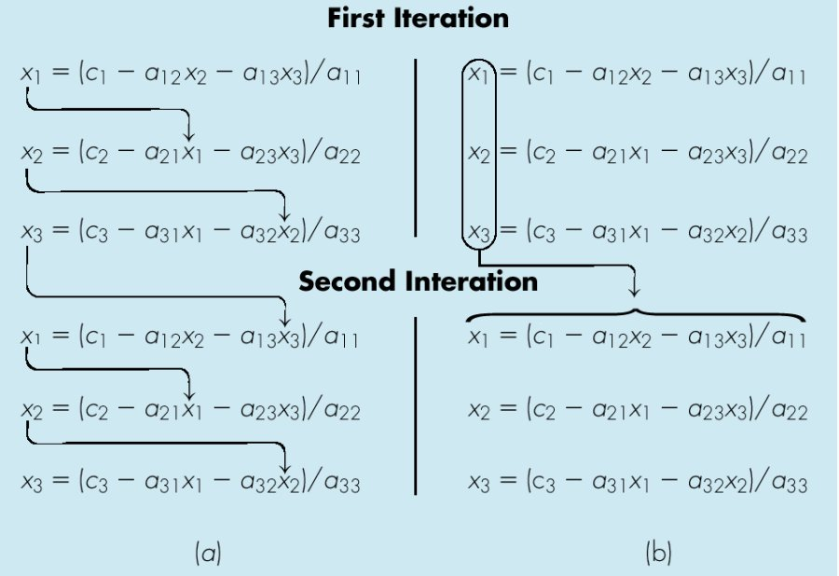
Gauss-Siedel
The Gauss-Seidel method
The Jacobi iteration method

Slide 7
Convergence Criterion for Gauss-Seidel Method
The gauss-siedel method is similar to the technique of fixed-point iteration.
The Gauss-Seidel method has two fundamental problems as any iterative method:
It is sometimes non-convergent, and
If it converges, converges very slowly.
Sufficient conditions for convergence of two linear equations, u(x,y) and v(x,y) are:

Slide 8
Convergence Criterion for Gauss-Seidel Method (cont’d)
Similarly, in case of two simultaneous equations, the Gauss-Seidel algorithm can be expressed as:

Slide 9
Convergence Criterion for Gauss-Seidel Method (cont’d)
Substitution into convergence criterion of two linear equations yield:
In other words, the absolute values of the slopes must be less than unity for convergence:
That is, the diagonal element must be greater than the off-diagonal element for each row (diagonally dominant ).

Slide 10
Gauss-Siedel Method- Example 1
Guess x₁, x₂, x₃= zero for the first guess
Iter. x₁ x₂ x₃ |e_{a,1}|(%) |e_{a,2}| (%) |e_{a,3}| (%)
0 0 0 0 - - -
1 2.6167 -2.7945 7.005610 100 100 100
2 2.990557 -2.499625 7.000291 12.5 11.8 0.076

Slide 11
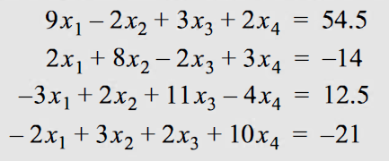
Ejercicio: Implemente un Script en Matlab para resolver el sistema usando el método de Gauss-Seidel. Usando 07 iteracciones.

Slide 12
Improvement of Convergence Using Relaxation
Where λ is a weighting factor that is assigned a value between [0, 2]
If λ = 1 the method is unmodified.
If λ is between 0 and 1 (under relaxation) this is employed to make a non convergent system to converge.
If λ is between 1 and 2 (over relaxation) this is employed to accelerate the convergence.

Slide 13
Gauss-Siedel Method- Example 2
Rearrange so that the equations are diagonally dominant

Slide 14
Gauss-Siedel Method- Example 2
iteration | unknown | value | ε_{a} | maximum ε_{a}
0 | x₁ | 0
 | x₂ | 0
 | x₃ | 0
1 | x₁ | 2.5 | 100.00%
 | x₂ | 7.166667 | 100.00%
 | x₃ | -2.7619 | 100.00% | 100.00%
2 | x₁ | 4.08631 | 38.82%
 | x₂ | 8.155754 | 12.13%
 | x₃ | -1.94076 | 42.31% | 42.31%
3 | x₁ | 4.004659 | 2.04%
 | x₂ | 7.99168 | 2.05%
 | x₃ | -1.99919 | 2.92% | 2.92%

Slide 15
Gauss-Siedel Method- Example 2
The same computation can be developed with relaxation where λ = 1.2
First iteration:
Relaxation yields:
Relaxation yields:
Relaxation yields:

Slide 16
Gauss-Siedel Method- Example 2
Iter. | unknown |  | value | relaxation | ε_{a} | maximum ε_{a}
1 | x₁ | 2.5 |  | 3 | 100.00%
 | x₂ | 7.3333333 |  | 8.8 | 100.00%
 | x₃ | -2.314286 |  | -2.777143 | 100.00% | 100.000%
2 | x₁ | 4.2942857 |  | 4.5531429 | 34.11%
 | x₂ | 8.3139048 |  | 8.2166857 | 7.10%
 | x₃ | -1.731984 |  | -1.522952 | 82.35% | 82.353%
3 | x₁ | 3.9078237 |  | 3.7787598 | 20.49%
 | x₂ | 7.8467453 |  | 7.7727572 | 5.71%
 | x₃ | -2.12728 |  | -2.248146 | 32.26% | 32.257%
4 | x₁ | 4.0336312 |  | 4.0846055 | 7.49%
 | x₂ | 8.0695595 |  | 8.12892 | 4.38%
 | x₃ | -1.945323 |  | -1.884759 | 19.28% | 19.280%

Slide 17
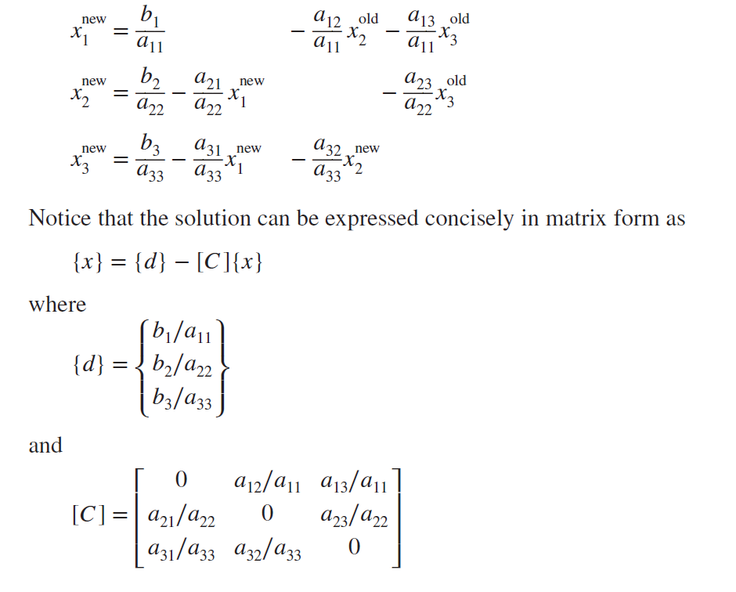
MATLAB M-file: Gauss Seidel Algorithm
Before developing an algorithm, let us first recast Gauss-Seidel in a form that is compatible with MATLAB’s ability to perform matrix operations

Slide 18
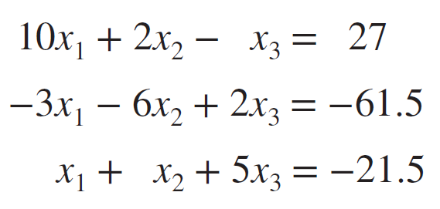
Exercise:
Use the Gauss-Seidel method in Matlab to solve the following system until the percent relative error falls below εs = 5%

